Slide 1
Causal Discovery of Gene Regulatory Networks on Tissue-Specific Human Cancer Gene Expression data
COM S 673: Advanced Topics in Computational Models of Learning
Group 3:
Yamini Mathur
Kumara Sri Harsha Vajjhala
Sai Charishma Valluri
Professor : Dr. Jin Tian

Slide 2
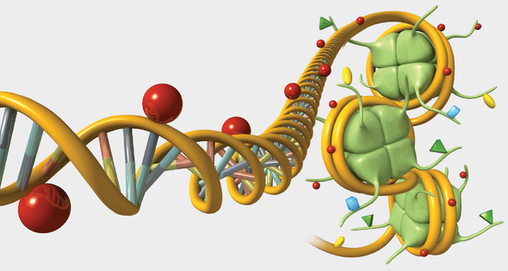
Introduction
Gene Expression Data:
It is a determination of the pattern of genes expressed, at the level of transcription, under specific circumstances
Gene Regulation:
It controls information about cellular functions and interaction between genes
Interactions b/w genes that regulate
Increase/Decrease production of RNA & Proteins
Gene Regulatory Networks can be estimated from Gene Expression Data using Causal Inference
Advantages of GRN discovery using Causal Inference:
Mathematically modeling biological networks, describes relationships b/w transcriptional factors and genes
Disease-pathways and disease-causing genes can be identified for diseases such as cancer and AIDS
Tested for various data like:
Breast Cancer Datasets, plants, insights into transcriptions of cancerous cells and many more
Notes:
https://blogs.scientificamerican.com/sa-visual/gene-regulation-illustrated/
https://hpi.de/fileadmin/user_upload/fachgebiete/plattner/teaching/TrendsBioinformatics/TiB2018/final_PhilippBode.pdf
https://www.semanticscholar.org/paper/Gene-Regulatory-Network-Inference%3A-An-Introductory-Huynh-Thu-Sanguinetti/ff0605a012929c7a478052a9a0e8dfb44984ae69
https://www.nature.com/subjects/gene-expression-profiling

Slide 3
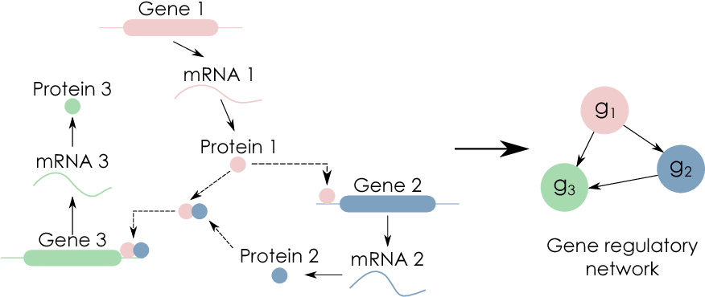
Introduction
Aim
To predict causal relationships
between sets of genes in gene expression data and thereby identify the Gene Regulatory Network
Approach
Implemented PC CMI
Extended to include edge orientations
Experimented with IC Algorithm
Compared PC CMI and IC Algorithm
Tested the algorithms on:
DREAM3 In-Silico Network Challenge Dataset
GTEX-TCGA Human Cancer Dataset
Notes:
https://blogs.scientificamerican.com/sa-visual/gene-regulation-illustrated/
https://hpi.de/fileadmin/user_upload/fachgebiete/plattner/teaching/TrendsBioinformatics/TiB2018/final_PhilippBode.pdf
https://www.semanticscholar.org/paper/Gene-Regulatory-Network-Inference%3A-An-Introductory-Huynh-Thu-Sanguinetti/ff0605a012929c7a478052a9a0e8dfb44984ae69
Approach:
Implemented PC CMI
Extended to include edge orientations
Experimented with IC Algorithm
Compared PC CMI and IC Algorithm
Tested the algorithms on
DREAM3 In-Silico Network Challenge Dataset and,
GTEX-TCGA Human Cancer Dataset

Slide 4
Datasets
Dream 3^{[4]} In-Silico Network Inference Challenge Dataset
GTEX-TCGA Human Cancer Dataset
A well studied real-world dataset of numerous cancer types (TCGA) and non-cancer (GTEX) gene expression data
A simulated gene expression dataset with interventional (gene-knockdown) data
The In-silico data was generated by continuous differential equations, which were reasonable approximations of the actual gene regulatory interactions. To this, a reasonable amount of gaussian noise was added.
The dataset consists of RNA-seq expression profiles of both cancer and non-cancer tissues
Two organisms : Yeast and E.coli
10, 50 and 100 node expression data for each organism
Three experiments:
Trajectories - Time course based on environmental perturbation
heterozygous mutants - gene knock-down
homozygous null mutants - gene knock-out
10 tissues, out of which we picked Breast and Lung
1054 samples for Breast - 965 tumor and 89 normal
804 samples for Lung - 491 tumor and 313 normal
The benchmark gene regulatory networks were obtained from The grand gene regulatory network database

Slide 5
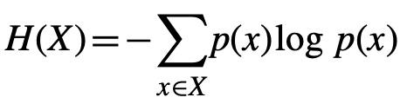
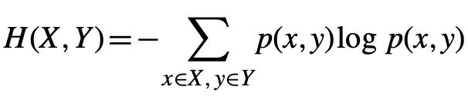

Methodology - PCA CMI
01
Entropy
Average uncertainty of variable X
02
Joint Entropy Average uncertainty of set of variables X,Y
03
Mutual Information(MI)
Dependence between two variables X and Y
04
Conditional Mutual Information (CMI)
Conditional dependency between two variables given other variable(s)
Notes:
entropy - average uncertainty of gene X

Slide 6
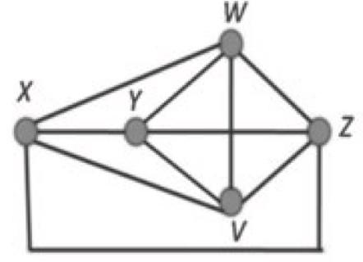
Methodology - PCA CMI
Step 0
Step 1
Step 2
Input gene expression data
set parameter 𝞱
generate complete network G for all genes
set L = -1
Increment L value by 1
For a non-zero edge G(i, j)!=0,
compute all the adjacent genes connected with both i and j
assign the count to the variable T.
If T >= L, select L genes from T adjacent genes and let them be K = {k₁,....k_{L}}
CMI(i, j|K) for all K and choose maximum one I_{max}(i, j|K).
If I_{max}(i, j|K) < 𝞱, set G(i, j)=0
Return to step 1

Slide 7
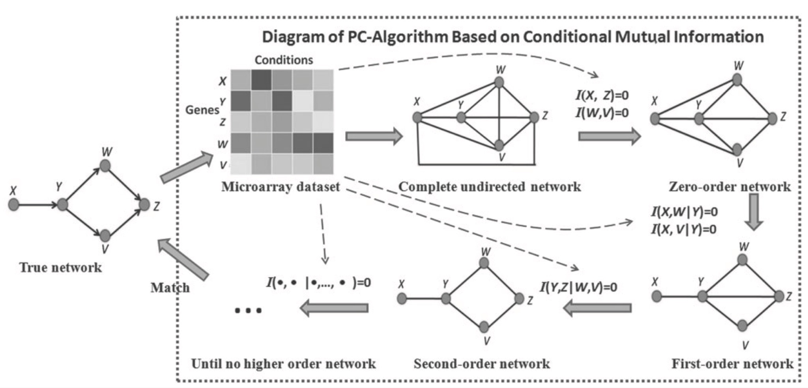
Methodology - PCA CMI

Slide 8
PC algorithm implementation
Method | Input | Output
conditional_mutual_info | gene1, gene2, gene3 (optional for mutual info) | CMI/MI value
pca_cmi | dataset, theta value, max order | predicted graph
remove_edges | predicted graph, dataset, L value, theta value | predicted graph
Notes:
conditional_mutual_info - given CMI and MI values for the given genes/nodes
pca_cmi, remove_edges - complete implementation of PCA - CMI algorithm

Slide 9

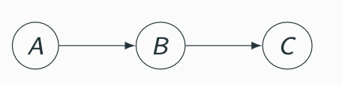
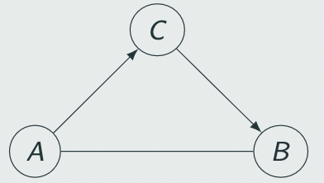
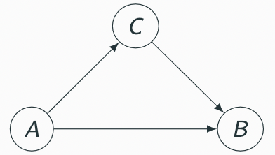
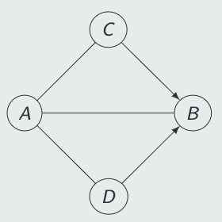
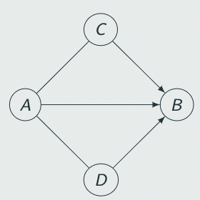
IC Algorithm Approach
IC Algorithm^{[5]} provides a way to identify which equivalence class a distribution belongs to, given the conditional independencies.
Skeleton Recovery
Identifying v-structures
Edge orientation
Start with an empty graph containing the vertices (V)
Search for a set S_{ab} such that conditional independence between a and b given S_{ab} (a ⊥ b|S_{ab}) holds in p({V})
Add an edge between a and b if such a set S_{ab} cannot be found
For each pair of non-adjacent nodes a and b with a common adjacent node c check if c belongs to S_{ab}
If it does, then continue.
If it does not, then add arrowheads pointing at c to the edges (i.e., a → c ← b).
Use the rules for edge orientation to orient as many edges as possible, such that they do not form cycles or v-structures
Notes:
PC - start with completely connected graph and remove edges - conditionally independent
IC - start with vertices and add edges - not conditionally independent

Slide 10
Edge Orientation - PCA-CMI and IC
Skeleton identification - For PCA-CMI, we developed our own implementation from the Zhang et al^{[6]}. paper and for IC algorithm , we used the implementation provided by Causal Inference 0.1.3 package in python.
V-structure identification and Edge orientation - Common for both PC-CMI and IC, which we developed using python.
Method | Input | Output
forms_v_shape | Adjacency matrix of the current graph, from_vertex, to_vertex | True - if edge forms a v-structure False - if not
forms_cycle | Adjacency matrix of the current graph, from_vertex, to_vertex | True - if edge forms a cycle False - if not
align_edges | Networkx graph, dataset table, theta | Returns an edge-oriented graph
Notes:
forms_v_shape - Returns true if adding the edge from from_vertex to true_vertex forms a v-structure. Else returns False
forms_cycle - Returns true if adding the edge from from_vertex to true_vertex forms a v-structure. Else returns False
align_edges - Method which runs the three rules to align edges

Slide 11
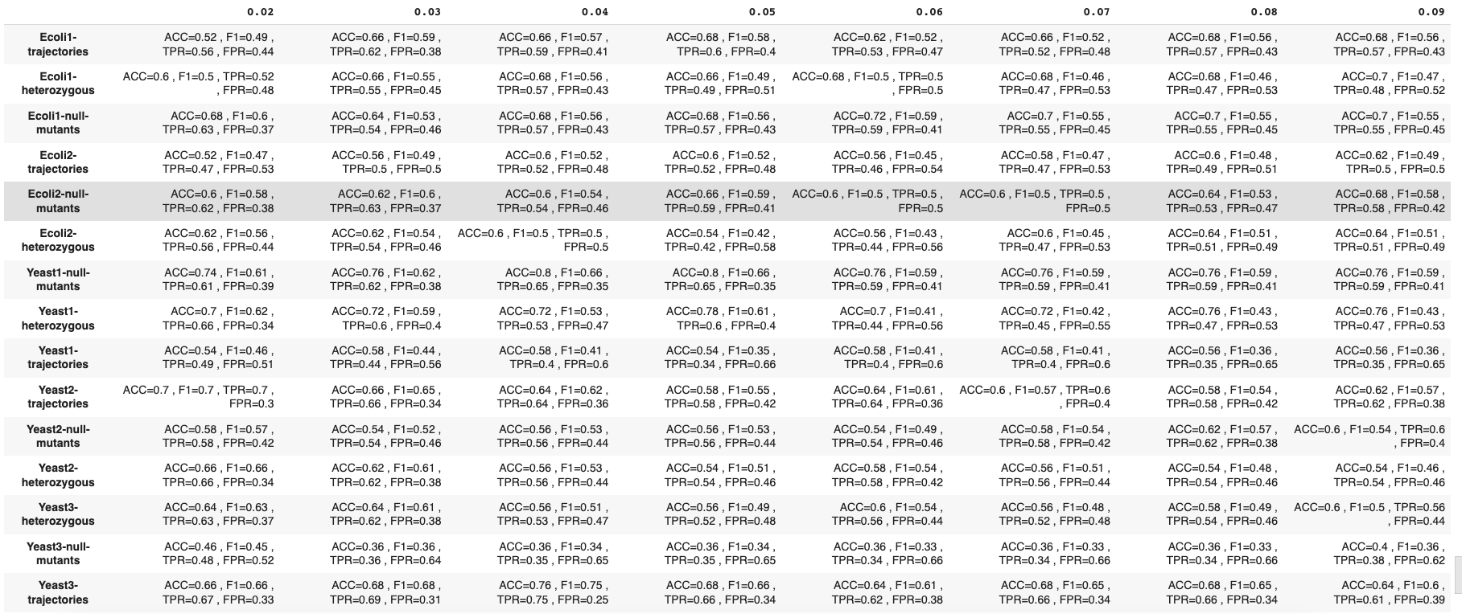
Results - PC CMI Skeleton Identification - Dream 3 - Size 10

Slide 12
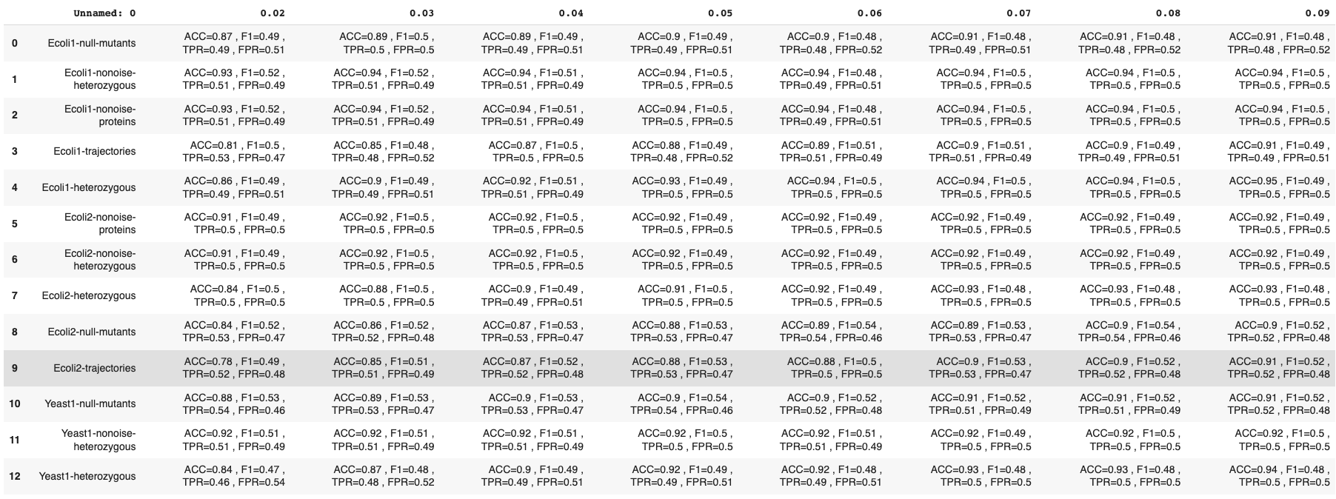
Results - PC CMI Skeleton Identification - Dream 3 - Size 50

Slide 13
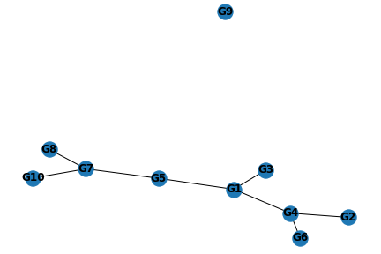
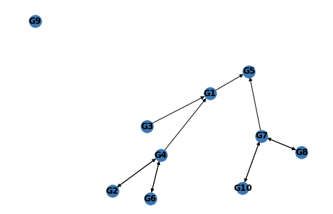
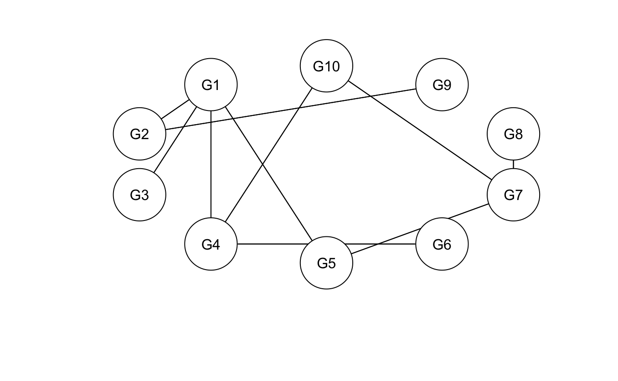
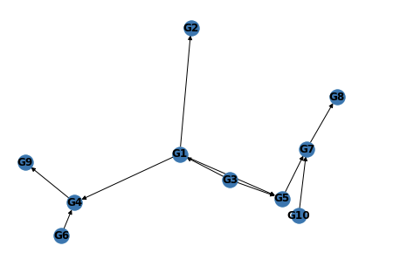
Results - PC CMI - Example
Yeast 1 PC-CMI Skeleton Prediction
Yeast 1 Edge Oriented graph
Yeast 1 Benchmark
Yeast 1 prediction using ARCANE

Slide 14
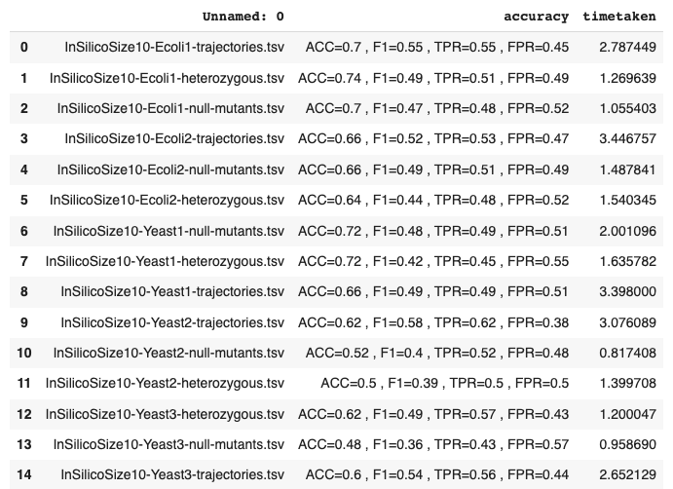
Results - IC - Skeleton Identification - Dream 3 - Size 10

Slide 15
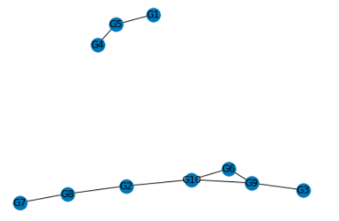
Results - IC Example
Yeast-1 IC no-noise Trajectories
Benchmark

Slide 16
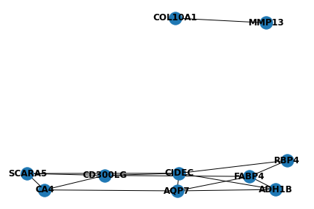
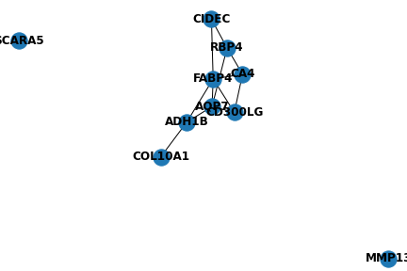
Results - Human Cancer Dataset
Gene Regulatory network predicted by PC-CMI for Breast Cancer (BRCA) tissue
Gene Regulatory network predicted by PC-CMI for Breast Normal tissue

Slide 17
References
[1] Christiansen, Jen. “Gene Regulation, Illustrated.” Scientific American Blog Network, 12 May 2016, blogs.scientificamerican.com/sa-visual/gene-regulation-illustrated.
[2] Bode, Philipp. “Trends in Bioinformatics: Causal Inference on Gene Expression Data.” Hasso Plattner Instuit, 2019, hpi.de/fileadmin/user_upload/fachgebiete/plattner/teaching/TrendsBioinformatics/TiB2018/final_PhilippBode.pdf.
[3] Huynh-Thu, Vân Anh and Guido Sanguinetti. “Gene Regulatory Network Inference: An Introductory Survey.” Methods in molecular biology 1883 (2019): 1-23 .
[4] Prill, Robert J et al. “Towards a rigorous assessment of systems biology models: the DREAM3 challenges.” PloS one vol. 5,2 e9202. 23 Feb. 2010, doi:10.1371/journal.pone.0009202
[4] Chicharro, Daniel, and Stefano Panzeri. “Algorithms of causal inference for the analysis of effective connectivity among brain regions.” Frontiers in neuroinformatics vol. 8 64. 2 Jul. 2014, doi:10.3389/fninf.2014.00064
[5] “Genomics and Transcriptomics Landscapes Associated to Changes in Insulin Sensitivity in Response to Endurance Exercise Training.” Nature, 2 Dec. 2021, www.nature.com/subjects/gene-expression-profiling?error=cookies_not_supported&code=24cc4de8-d75e-47c8-944d-7b1545d147fa.
[6] Xiujun Zhang, Xing-Ming Zhao, Kun He, Le Lu, Yongwei Cao, Jingdong Liu, Jin-Kao Hao, Zhi-Ping Liu, Luonan Chen, “Inferring gene regulatory networks from gene expression data by path consistency algorithm based on conditional mutual information”, Bioinformatics, Volume 28, Issue 1, 1 January 2012, Pages 98–104, https://doi.org/10.1093/bioinformatics/btr626
Technologies used: Python, Pandas, Numpy, Networkx, SciPy, causality.inference.search, R
Project Github Repository: https://github.com/vksriharsha/Causal-Inference-on-Gene-Expression-Data

Slide 18
Questions?

